Slide 1
Recitation6
李磊
2023/10/18

Slide 2
Announcements
Attacklab将于10/24due, 10/26ddl, 请大家合理安排时间
Archlab预计将于今晚24:00发布, 12天due, 14天ddl
Archlab开始注意提交次数限制
建议下周回课的同学提前把准备的题目发到群里
关于lab, 期中复习, 期末复习回课安排

Slide 3
Schedule
梁科, 刘晋铭两位同学回课
助教回顾本周重点内容和相关往年题
略微讲一点4.3 SEQ

Slide 4
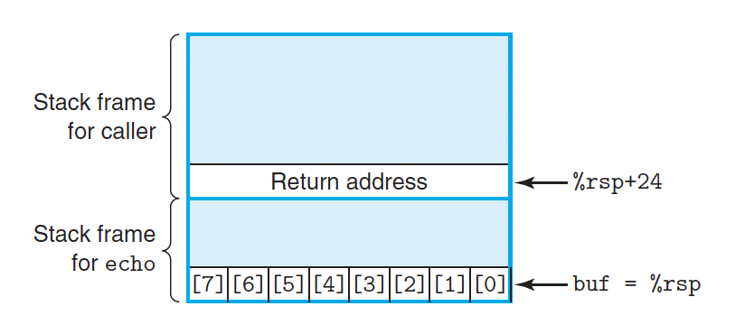
Buffer Overflow
No Boundary Checks
Invalid array references
Unchecked Copy Operations
Unchecked strcpy, strcat, ……
Input Validation Issues
Unchecked gets, scanf, cin……

Slide 5
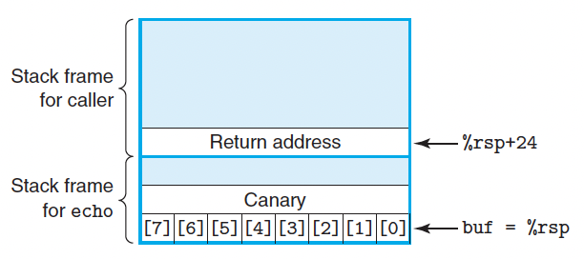
Buffer overflow -- solutions
Use safe functions
Prevent code execution on the stack.
stack randomization(ASLR)
Utilize stack canaries
Hardware, OS and compiler provide all sorts of protection, but you should write your code carefully to avoid unsafety in your program!

Slide 6
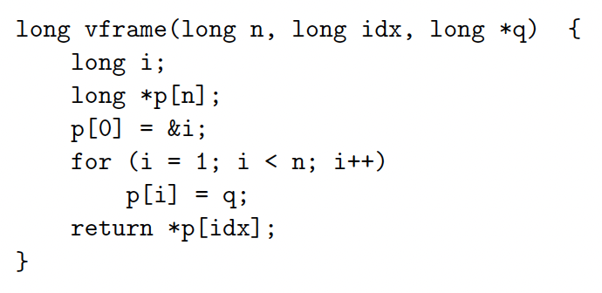
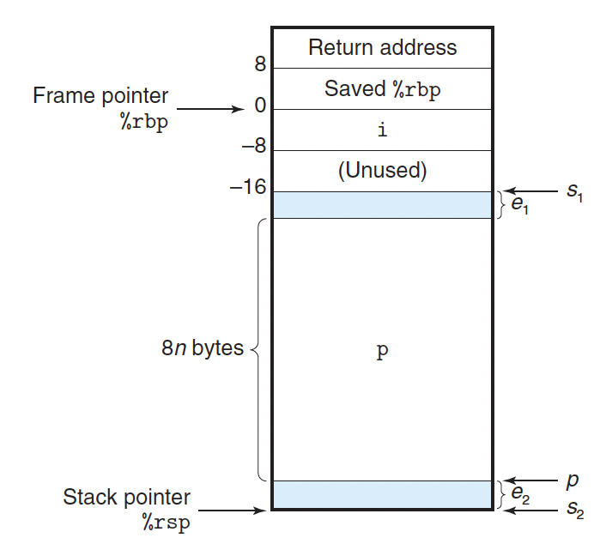
Variable-Size Stack Frames
Used in variable size array
Use the frame pointer %rbp
So that we can easily restore %rsp
Leave instruction
Equivalent to
movq %rbp, %rsp
popq %rbp

Slide 7
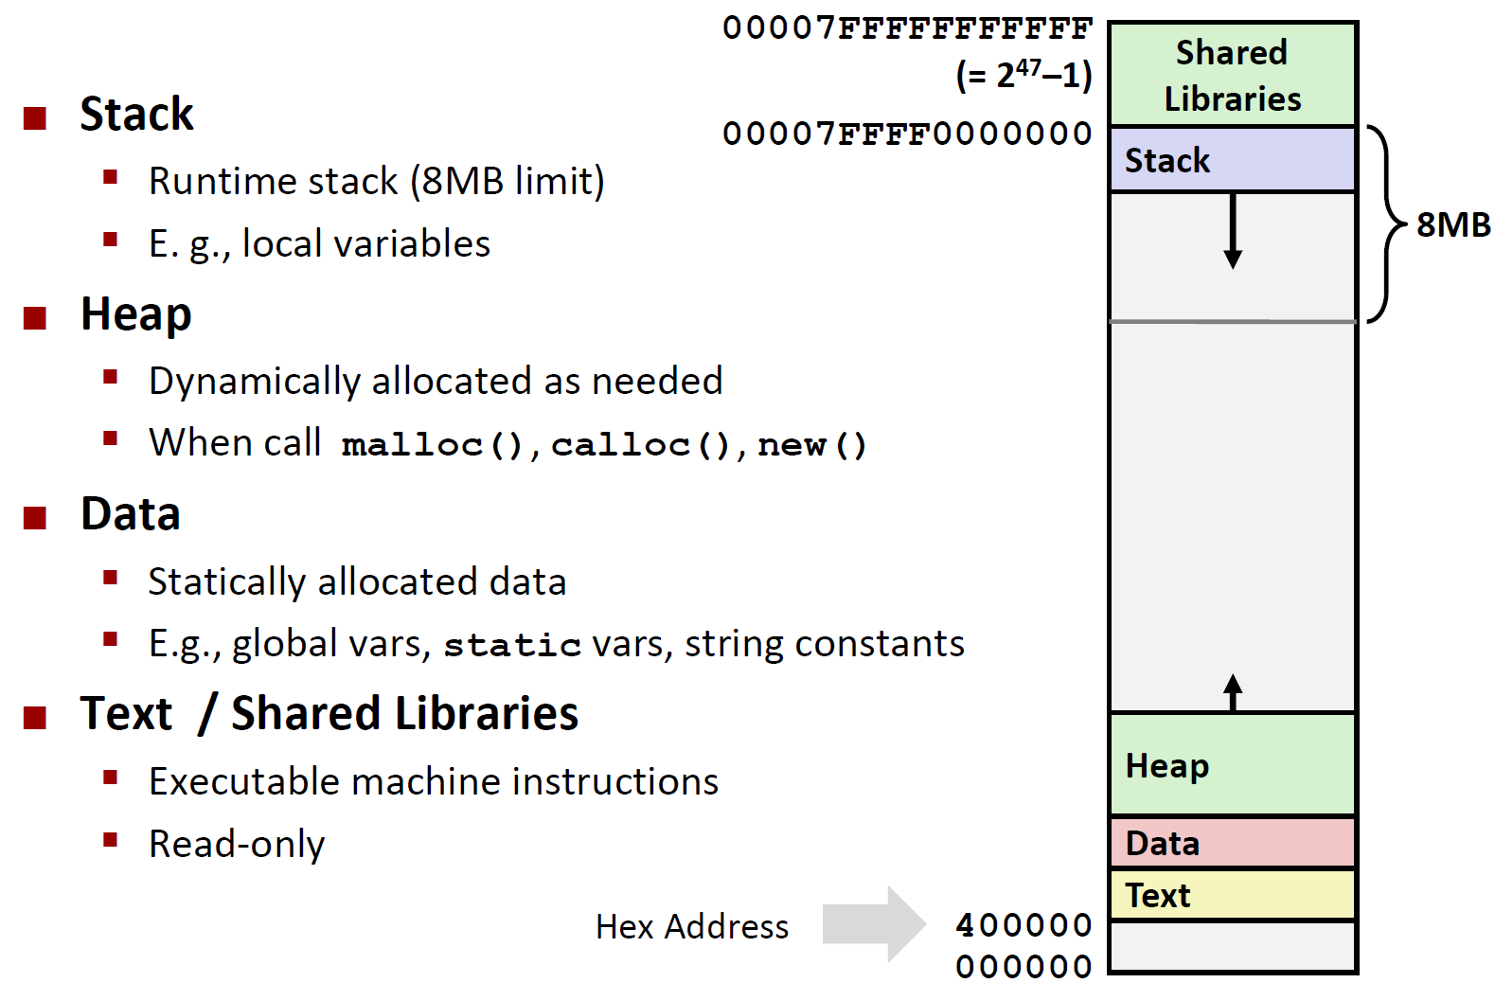
Memory Layout
Kernel Space

Slide 8
End of chapter 3
ANY QUESTIONS?

Slide 9
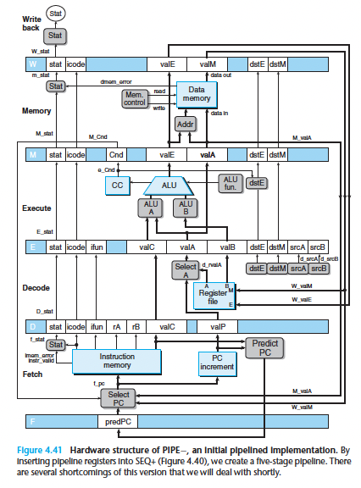
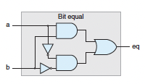
Overview
temp = v[k];
v[k] = v[k+1];
v[k+1] = temp;
High Level Language Program (e.g., C)
movl 0(%rdi), %eax
movl 4(%rdi), %edx
movl %edx, 0(%rdi)
movl %eax, 4(%rdi)
Assembly Language Program (e.g., x86, RISC-V)
Machine Language Program (e.g., x86, RISC-V)
0x 8b 07 8b 57 04 89 17 89 47 04
Hardware Architecture Description (e.g., block diagrams)
Logic Circuit Description (Circuit Schematic Diagrams)

Slide 10
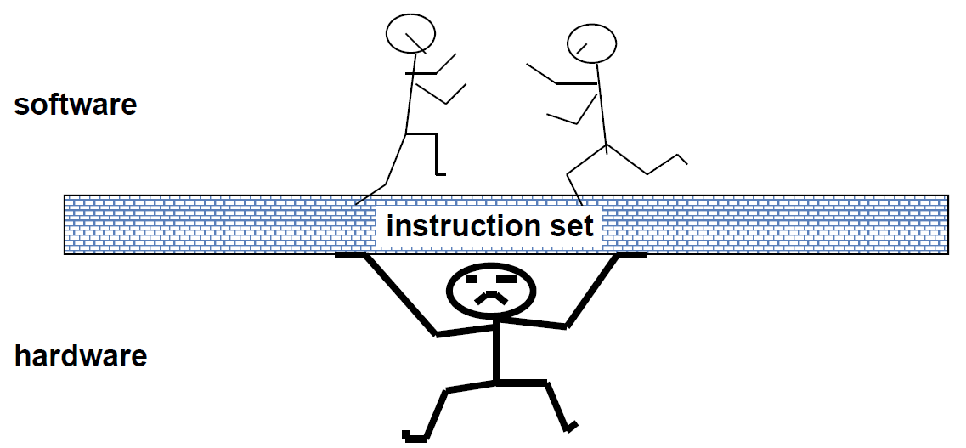
What is ISA?
Computer designers have a common goal: to find a language that makes it easy to build the hardware and the compiler while maximizing performance and minimizing cost and energy.

Slide 11
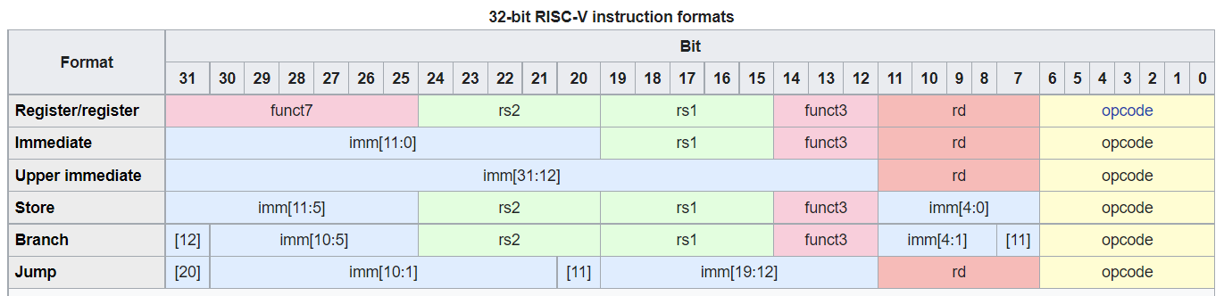
About CISC & RISC (*)
Complex instruction set computer v.s Reduced instruction set computer

Slide 12
Instruction Set Architectures
Early trend was to add more and more instructions to new CPUs to do elaborate operations
CISC philosophy
Instruction set is complicated so that tasks can be completed in as few lines of assembly as possible
Programmers can write assembly code more easily
RISC philosophy
Keep the instruction set small and simple, makes it easier to build fast hardware.
Let software do complicated operations by composing simpler ones.
Y86-64
combines the distinct characteristics of both RISC and CISC architectures
cannot categorize it simply as either RISC or CISC

Slide 13
Patterson and Hennessy win Turing!
For pioneering a systematic, quantitative approach to the design and evaluation of computer architectures with enduring impact on the microprocessor industry.

Slide 14
CISC v.s. RISC
CISC | RISC
Multiple formats for specifying operands | Simple addressing formats
Arithmetic and logical operations can be applied to both memory and register operands | only use register operands.
Condition codes | no condition codes
Stack-intensive procedure linkage | Register-intensive procedure linkage

Slide 15
CISC v.s. RISC
CISC | RISC
Emphasis on hardware | Emphasis on software
Includes multi-clock complex instructions | Single-clock, reduced instruction only
Memory-to-memory: "LOAD" and "STORE" incorporated in instructions | Register to register: "LOAD" and "STORE" are independent instructions
Small code sizes, high cycles per second | Low cycles per second, large code sizes

Slide 16
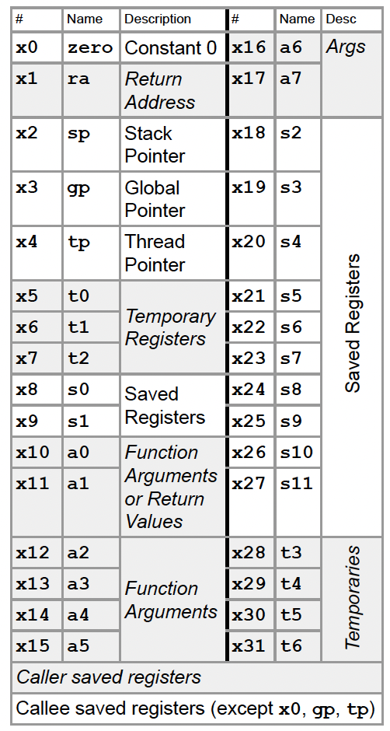
RISCV (*)
Category | Instr | Op Code | Example | Meaning
Arithmetic (R & I format) | add | 0110011 | add x5, x6, x7 | x5 = x6 + x7
 | subtract | 0110011 | sub x5, x6, x7 | x5 = x6 - x7
 | add immediate | 0010011 | addi x5, x6, 20 | x5 = x6 + 20
 | or immediate | 0010011 | ori x5, x6, 20 | x5 = x6 | 20
Data Transfer (I & U format) | load double word | 0000011 | ld x5, 40(x6) | x5 = Memory[x6 + 40]
 | store double word | 0100011 | sd x5, 40(x6) | Memory[x6 + 40] = x5
 | load byte | 0000011 | lb x5, 40(x6) | X5(7:0) = Memory[x6 + 40](7:0)
 | store byte | 0100011 | sb x5, 40(x6) | Memory[x6 + 40](7:0) = x5(7:0)
 | load upper imm | 0110111 | lui x5, 0x12345 | x5 = 0x12345000
Cond. Branch (SB format) | br on equal | 1100111 | beq x5, x6, 100 | if (x5 == x6) go to PC+100
 | br on not equal | 1100111 | bne x5, x6, 100 | if (x5 != x6) go to PC+100
Jump (UJ and I format) | jump and link jump and link reg. | 1100111 1101111 | jal x1, imm jalr x0, 0(x1) | x1 = PC+4; PC = PC+{imm,1’b0}

Slide 17
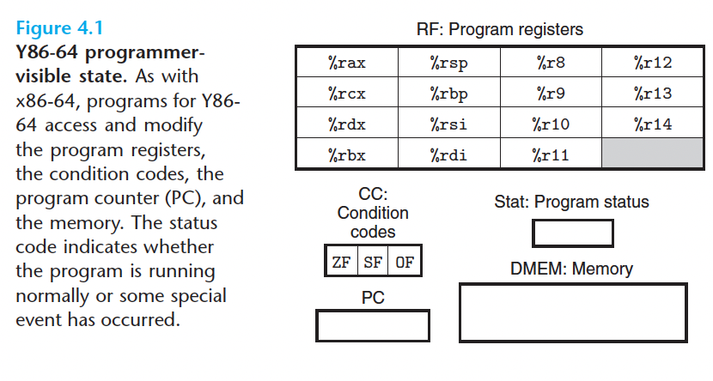
Programmer-Visible State
15 registers instead of 16
Easy For encoding
CC code
To implement conditional jump
PC
Stat
DMEM (data memory)

Slide 18
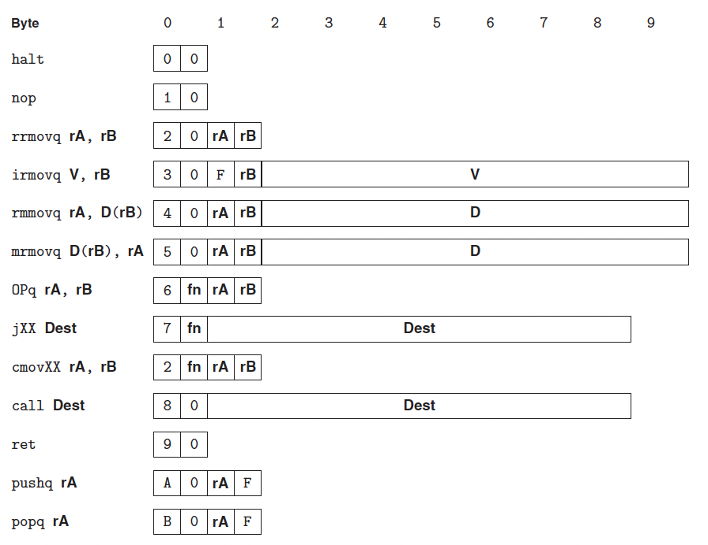
Y86-64 Instructions
For educational purpose
Different length for different instructions
Understand the rule of encoding of different instructions
F stands for no registers

Slide 19
Y86-64 Instructions
Cannot be simply classfied as CISC or RISC
Immediates are always 8 bytes for simplicity
Unique interpretation

Slide 20
Special instructions
popq %rsp
Set %rsp to the value read from the memory
pushq %rsp
Push the original value of rsp

Slide 21
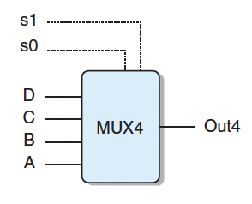
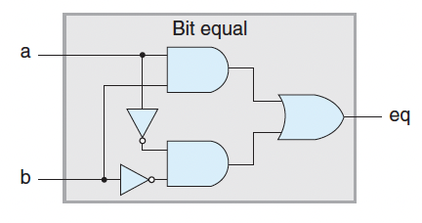
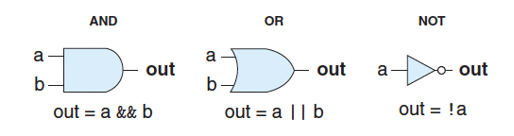
Basic hardware & HCL
Micro-Architecture (execution pipeline)
Logic (adders, multiplexers)
Digital Circuits (logic gates)

Slide 22
HCL (Hardware control language)
Operations:
bool out = (s && a) || (!s && b)
Case expression: word out = [select1: expr1, select2: expr2 ...]
bool s = code in {item1, item2, ...}
Differences from C Logic Operations:
Combinational circuits provide continuous response to changes in inputs.
HCL lacks "short-circuiting" as seen in C, and it does not partially evaluate expressions.

Slide 23
AND & OR & NOT
As is mentioned before, we can use nand gates to construct the three basic logic gates.

Slide 24
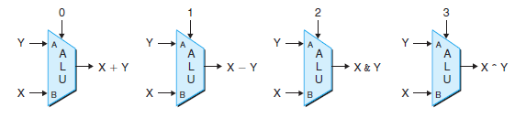
Combinational circuits
Built on logic gates
Has input, output
E.g. Multiplexor, ALU

Slide 25
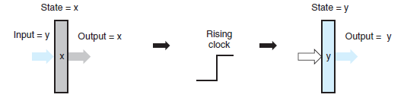
Sequential circuits
To store the information when a program runs
Controlled by a single clock
Note the difference of sequential circuits and combinational circuits
E.g. register files, memory, CC, PC

Slide 26



Aside: Machine Clock Rate
Clock rate (MHz, GHz) is inverse of clock cycle time (clock period)
CC = 1 / CR
one clock period
10 nsec clock cycle => 100 MHz clock rate
5 nsec clock cycle => 200 MHz clock rate
2 nsec clock cycle => 500 MHz clock rate
1 nsec clock cycle => 1 GHz clock rate
500 psec clock cycle => 2 GHz clock rate
250 psec clock cycle => 4 GHz clock rate
200 psec clock cycle => 5 GHz clock rate

Slide 27
Aside: Meaning of Single Cycle
The clocking methodology defines when signals can be read and when they are written
An edge-triggered methodology
Typical execution
❶ Read contents of state elements
❷ Send values through combinational logic
❸ Write results to one or more state elements
State
Element 1
Combinational
logic
State
Element 2
clock
One clock cycle

Slide 28
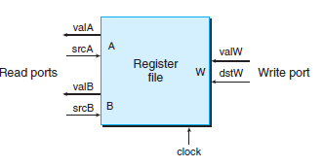
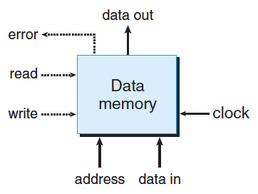
Register & Memory
Register file
Two read ports and one write port
(However, the register file in Y86 has two write ports)
Remains in a fixed state for most time
valA is read from srcA (similar for B)
valW is writen to dstW if dstW is a valid register
Data memory (DMEM)
One read port and one write port
Address & data in used for write
Data out generated from the read port

Slide 29
Examples
( )4.对应下述组合电路的正确 HCL 表达式为
A. Bool X = (A || B) && (A || C)
B. Bool X = A || (B && C)
C. Bool X = A && (B || C)
D. Bool X = A || B || C
C
这也启示我们可以使用布尔代数化简来减少logic gate的数量

Slide 30
Examples
( )1.下面有三组对于指令集的描述，它们分别符合①____，②____，③____ 的特点。
① 某指令集中，只有两条指令能够访问内存。
② 某指令集中，指令的长度都是4字节。
③ 某指令集中，可以只利用一条指令完成字符串的复制，也可以只利用一条指令查找字符串中第一次出现字母K的位置。
A. CISC, CISC, CISC
B. RISC, RISC, CISC
C. RISC, CISC, RISC
D. CISC, RISC, RISC
B

Slide 31
Principle of hardware design
Simplicity
Less hardware
Different instructions share the same hardware
Performance
Higher throughput
Lower delay

Slide 32
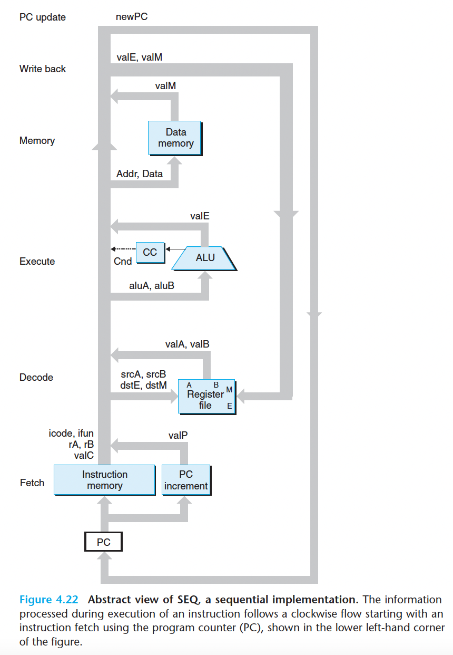
Sequential Y86-64 Implementations
Five stages (FDEMW)
Fetch
Decode
Execute
Memory
Writeback

Slide 33
Now, let’s take a look at particular instructions

Slide 34
Instruction | Fetch | Decode | Execute | Memory r/w | Writeback | PC update
cmovxx | ifun; rA; rB; valP=PC+2 | valA=R[rA] valB=0 | valE=valB+valA cnd=Cond(CC,ifun) |  | if(cnd): R[rB]=valE | PC=valP
irmov | rB; valC; valP=PC+10 |  | valE=0+valC |  | R[rB]=valE | PC=valP
rmmov | rA; rB; valC; valP=PC+10 | valA=R[rA] valB=R[rB] | valE=valB+valC | M₈[valE]=valA |  | PC=valP
mrmov | rA; rB; valC; valP=PC+10 | valB=R[rB] | valE=valB+valC | valM=M₈[valE] | R[rA]=valM | PC=valP
OP | ifun; rA; rB; valP=PC+2 | valA=R[rA] valB=R[rB] | valE=valA OP valB Set CC |  | R[rB]=valE | PC=valP
jxx | ifun; valC; valP=PC+9 |  | cnd=Cond(CC,ifun) |  |  | PC=cnd? valC : valP
call | valC; valP=PC+9 | valB=R[%rsp] | valE=valB+(-8) | M₈[valE]=valP | R[%rsp]=valE | PC=valC
ret |  | valA=R[%rsp] valB=R[%rsp] | valE=valB+8 | valM=M₈[valA] | R[%rsp]=valE | PC=valM
push | rA; valP=PC+2 | valA=R[rA] valB=R[%rsp] | valE=valB+(-8) | M₈[valE]=valA | R[%rsp]=valE | PC=valP
pop | rA; valP=PC+2 | valA=R[%rsp] valB=R[%rsp] | valE=valB+8 | valM=M₈[valA] | R[%rsp]=valE R[rA]=valM | PC=valP

Slide 35
Points worth noting
Remember what each state does!
Remember the meaning of rA, rB, valA, valB, valC, valE, valM
Note the order of some instruction (think of: push %rsp & pop %rsp)
Use 'cond,' 'cnd,' and 'CC' in the correct format

Slide 36
Examples (2020)

Slide 37
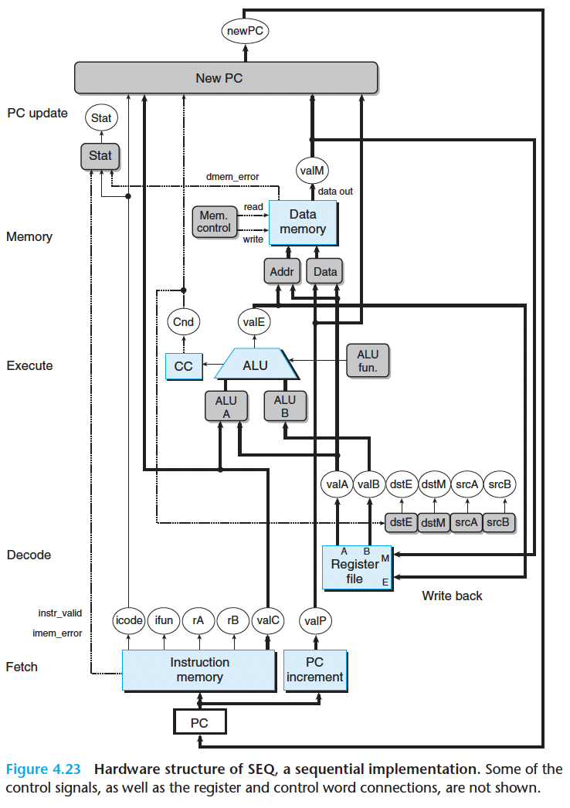
Hardware structure
Notice the color of different units
Blue, gray and white
Five stages
Note the relationship between datapath & control logic
HCL only describes the control logic

Slide 38
Combinational Circuit & Sequential Circuit
Combinational Circuit
does not require any sequencing or control
values propagate through a network of logic gates whenever the inputs change
Sequential Circuit
controlled via a single clock signal
Triggered by a clock transition

Slide 39
Examples
Combinational Circuit or Sequential Circuit?
Register files?
Data memory?
ALU?
CC?
Instruction memory?
PC?

Slide 40
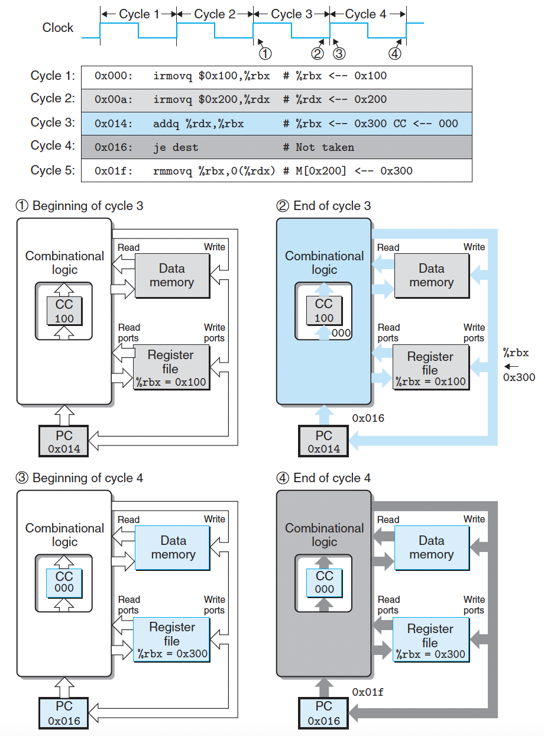
Example
State are updated as clock rises
CC
DMEM
Register file
PC
The output of combinational logic just changes as their inputs change
ALU
Memory reads

Slide 41
Make it better?
One clock cycle take too long time;
Most parts of the processor are idle at most time in one cycle;

